Slide 1


WALMART
SALES ANALYSIS
Using MS SQL
Presented by Pooja S.
For Mentorness
Under Batch - MIP-DA-13

Slide 2

CONTENTS
Introduction
Project Overview
DataSet Overview
Analysis and Insights
Findings
Conclusion

Slide 3


INTRODUCTION
Walmart Inc. is a global retail giant founded in 1962 by Sam Walton. Headquartered in Bentonville, Arkansas, Walmart operates a chain of hypermarkets, discount department stores, and grocery stores. It is one of the largest and most recognized retail brands in the world, with over 10,000 stores across more than 20 countries and a workforce exceeding 2 million associates.
Walmart is renowned for its commitment to providing a wide range of products at competitive prices, serving millions of customers daily. The company's extensive supply chain and innovative use of technology enable it to maintain its position as a leader in the retail sector. Walmart's mission is to save people money and help them live better by offering high-quality products and services at affordable prices.

Slide 4

PROJECT
OVERVIEW
The Walmart Sales Analysis project aims to leverage SQL to extract and analyze sales data, uncovering valuable insights into the company's performance. By focusing on key metrics such as sales trends, product wise performance, and payment methods, this project seeks to provide a comprehensive understanding of sales dynamics. The analysis involves querying data from various sources to identify patterns and trends over time. This approach enables Walmart to make informed decisions about inventory management, marketing strategies, and store operations.
Through the use of SQL, the project will generate reports on monthly sales trends, departmental contributions, and store performance. The insights derived from these analyses will help Walmart optimize its inventory, tailor promotions to specific departments and stores, and strategically plan store placements. Ultimately, the goal is to support data-driven decision-making that enhances overall business performance and customer satisfaction.

Slide 5


DATASET
OVERVIEW
• Invoice_ID: Unique identifier for each invoice.
• Branch: Branch of the store where the sale took place.
• City: City where the store branch is located.
• Customer_type: Type of customer (e.g., Member, Normal).
• Gender: Gender of the customer.
• gross_income: Gross income from the sale.
• Rating: Customer rating for the purchase.
• Product_line: Category of the product sold.
• Unit_price: Price per unit of the product.
• Quantity: Quantity of the product sold.
• Tax_5%: Tax applied on the sale.
• Total: Total amount of the sale.
• Date: Date of the transaction.
• Time: Time of the transaction.
• Payment: Payment method used (e.g., Cash, Credit Card).
• cogs: Cost of goods sold.
• gross_margin_percentage: Gross margin percentage.

Slide 6
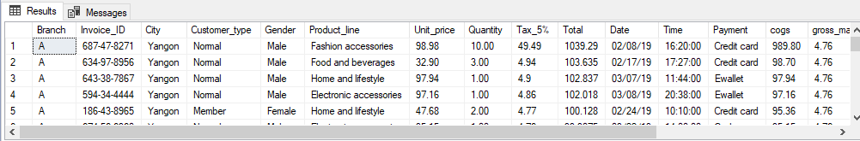
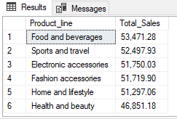
ANALYSIS
USING SQL
1. Retrieve all columns for sales made in a specific branch (e.g., Branch 'A')
Select * ,
format (unit_price * quantity, 'N2' ) as Sales from walmartdata --(N2' specifies numeric value with two decimal places)
where branch = 'A'
order by sales desc
2. Find the total sales for each product line
select Product_line,
format(sum(unit_price * quantity ),'N2') as Total_Sales from walmartdata
group by product_line
order by Total_sales desc

Slide 7
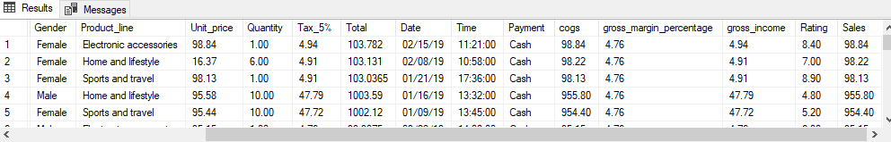
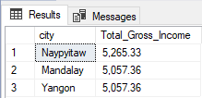
3. List all sales transactions where the payment method was 'Cash'
Select * ,
format (unit_price * quantity, 'N2' ) as Sales from walmartdata
where payment = 'cash'
order by sales desc
4. Calculate the total gross income generated in each city
select city,
format(sum(gross_income),'N2') as Total_Gross_Income from walmartdata
group by City
order by Total_Gross_Income desc

Slide 8
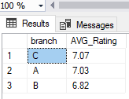
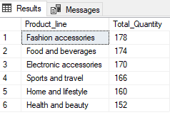
5. Find the average rating given by customers in each branch
Select branch,
format ( Avg(rating), 'N2') as AVG_Rating from walmartdata
group by branch
order by AVG_Rating desc
6. Determine the total quantity of each product line sold
select Product_line,
count(quantity ) as Total_Quantity from walmartdata
group by product_line
order by Total_quantity desc

Slide 9
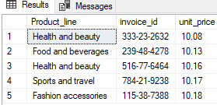
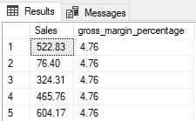
7. List the top 5 products by unit price
Select top 5 Product_line,
invoice_id,
unit_price from walmartdata
order by unit_price
8. Find sales transactions with a gross margin percentage greater than 3%
Select format((unit_price * quantity), 'N2') As Sales,
gross_margin_percentage from walmartdata
where gross_margin_percentage > 3

Slide 10
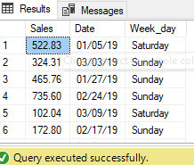
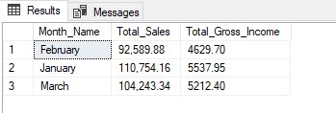
9. Retrieve sales transactions that occurred on weekends
Select format((unit_price * quantity), 'N2') As Sales,
Date,
datename(weekday, date) as Week_day from walmartdata
where datename(weekday, date) in ('saturday','sunday')
10. Calculate the total sales and gross income for each month
Select datename(Month,date) As Month_Name,
format(sum((unit_price * quantity)), 'N2') As Total_Sales,
sum(gross_income) As Total_Gross_Income from walmartdata
group by datename(Month,date)

Slide 11
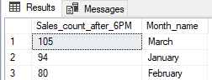
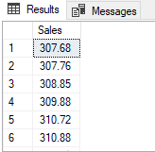
11. Find the number of sales transactions that occurred after 6 PM
select count(unit_price * quantity) As Sales_count_after_6PM,
datename(month,date) as Month_name from walmartdata
where time > '18:00:00'
group by datename(month,date)
order by sales_count_after_6PM desc
12. List the sales transactions that have a higher total than the average total of all transactions
select format((unit_price * quantity), 'N2') As Sales from walmartdata
where (unit_price * quantity) > (select avg(unit_price * quantity) from walmartdata )
order by sales

Slide 12
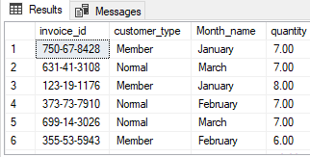
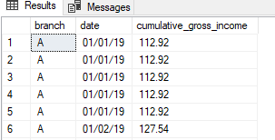
13. Find customers who made more than 5 purchases in a single month
select invoice_id,customer_type,
datename(month,date) as Month_name,
quantity from walmartdata
where quantity > 5
14. Calculate the cumulative gross income for each branch by date
select branch,
date,
sum(gross_income) over (partition by branch order by date ) as cumulative_gross_income from walmartdata
order by branch, date

Slide 13

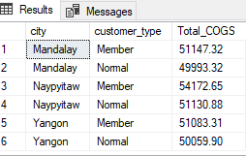
15. Find the total cogs for each customer type in each city
Select city,
customer_type,
sum(cogs) as Total_COGS from walmartdata
group by city, customer_type
order by city

Slide 14
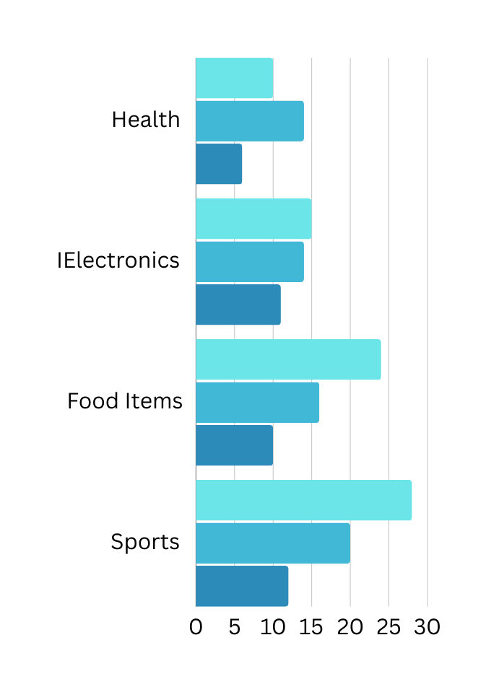
FINDINGS
The SQL queries provided facilitate a comprehensive analysis of Walmart's sales data across various dimensions. By retrieving detailed transaction records for specific branches, calculating total sales for each product line, and examining payment methods, we gain valuable insights into sales performance, customer preferences, and financial metrics. For instance, determining gross income by city and assessing average customer ratings by branch allows Walmart to pinpoint high-performing areas and understand customer satisfaction. Additionally, identifying high-value transactions and weekend sales patterns helps in fine-tuning inventory management and marketing strategies.

Slide 15


CONCLUSION
The comprehensive analysis of Walmart's sales data reveals critical insights into sales performance and operational efficiency. By examining transaction details across branches and cities, evaluating product line performance, and analyzing customer payment methods and ratings, we gain a nuanced understanding of factors driving revenue and customer satisfaction.
The detailed findings, such as the cumulative gross income by branch and the distribution of COGS by customer type and city, further refine our understanding of profitability and cost management. By leveraging these insights, Walmart can implement targeted strategies to enhance sales, optimize resource allocation, and improve overall customer experience. Ultimately, the analysis not only supports data-driven decision-making but also positions Walmart to adapt to evolving market conditions and drive sustained growth.

